Slide 1
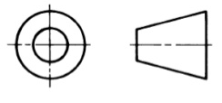
Drawing a hexagonal nut
2D
D
D
R=1.5D

